Slide 1
UNFPA SUPPLIES PARTNERSHIP
Estimated budgets - July 2023

Slide 2
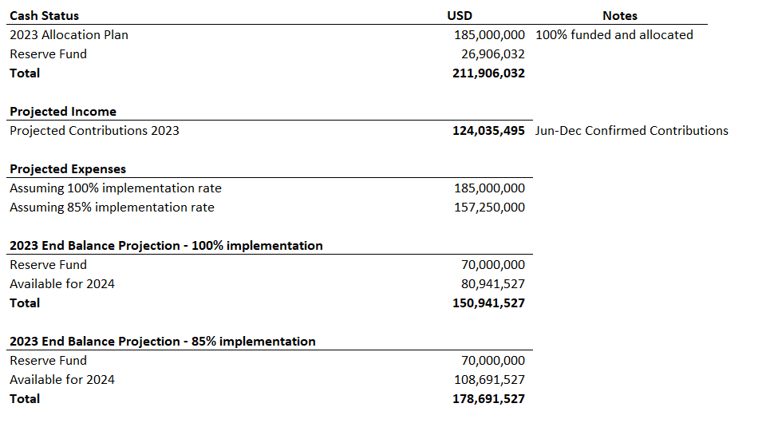
2023 Cash Balance
The programme has allocated 100% of the planning amount of $185 million
The current Reserve Fund balance is $26.9 million
It is expected that the approved reserve fund balance of $70 million will be reached in June/July
Assuming an 85% implementation rate, the end balance in 2023 will be $109 million in addition to the reserve. $179 million in total.
The end balance will be carried forward for programming in the following year

Slide 3
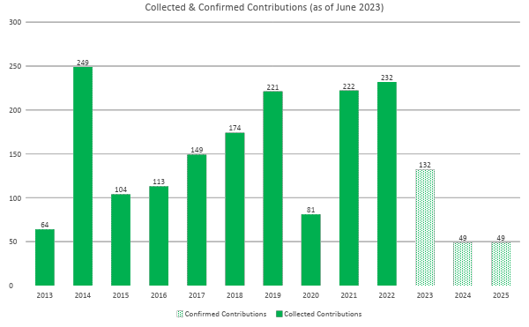
Donor Contributions – 2013 - 2025

Slide 4
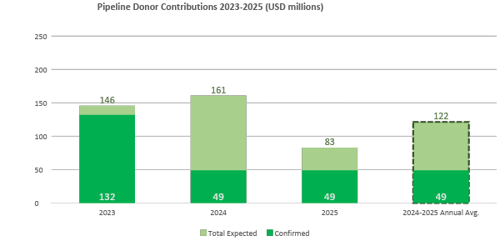
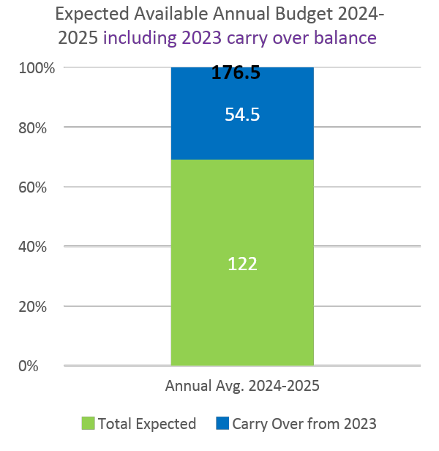
Donor Contributions – 2021 - 2025
The average annual confirmed donor contribution for 2024 and 2025 is $49 million
The average annual confirmed and expected donor contribution for 2024 and 2025 is $122 million
The expected annual available budget including carry over balance from 2023 comes to $176.5 million

Slide 5
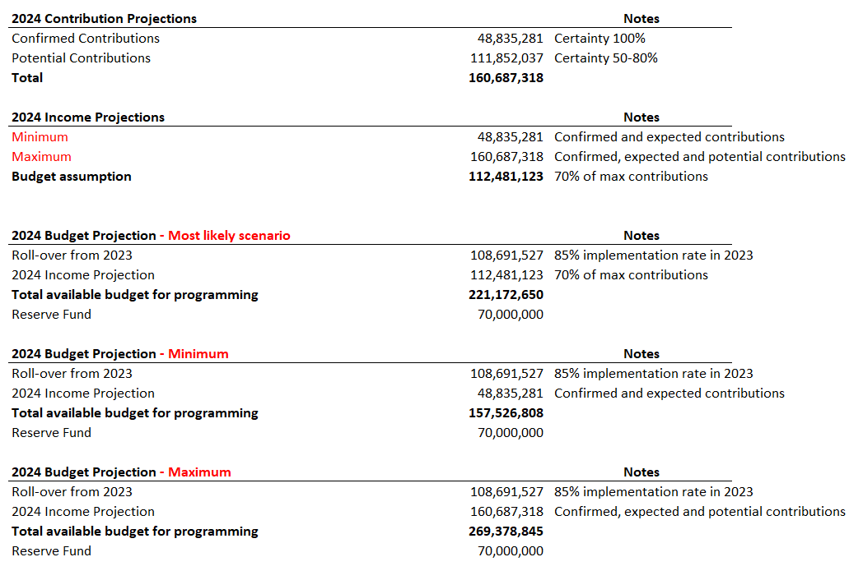
2024 Budget Estimate
The expected income in 2024 is between $49-161 million
The most likely income is $112 million but the uncertainty is high.
The projected income in 2024 and expected roll-over from 2023 gives an available. programme budget of $221 million in 2024 – but the uncertainty is high.

